Slide 1
A PRESENTATION ON NOISE POLLUTION

Slide 2
INTRODUCTION
unwanted or undesirable sound
group of loud, non-harmonious sounds or vibrations that are unpleasant and irritating to our ear
it is a relative thing
the sound that pleases one person may become noise for another person

Slide 3
QUANTIFICATION OF SOUND
Sound power: Rate at which a source produces and radiates acoustical or sound energy per unit time.
Sp = 10 log10 Pc/Po, dB
where,
Pc – measured sound energy, W
Po - reference sound power, 10^ (-12) W

Slide 4
Sound intensity: The sound intensity is the sound power transmission through a surface (W/m²) - a vector quantity with direction through a surface.
Human hearing is directly sensitive to sound pressure which is related to sound intensity
The Sound Pressure is the force (N) of sound on a surface area (m²) perpendicular to the direction of the sound. Measured by microphone in air.
I = SI = P^2/(ρ.v), W/m2
where,
P – sound pressure, Pa;
ρ – density of media, kg/m3;
v – speed of sound, m/s

Slide 5

Sound Power level (PWL):
rate at which a source produces and radiates acoustical or sound energy
Sound pressure level (SPL):
measures the acoustical power applied over an area. Sound pressure level (SPL) is a logarithmic measure of the effective pressure of a sound relative to a reference value.
Where, p is the root mean square sound pressure;^{[5]}
p₀ is the reference sound pressure;
Noise level is measured by a Sound level meter.
A decibel (dB) is the standard for the measurement of noise.

Slide 6
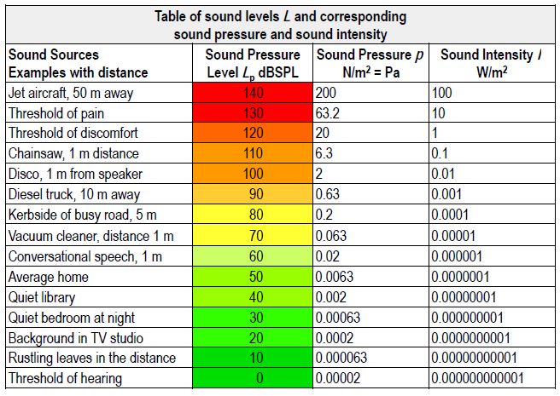

Slide 7
CAUSES OF NOISE POLLUTION
Industrialization, urbanizations and modern civilization
Construction activities
Social activities
industrial and non-industrial sources
natural or man-made

Slide 8
EFFECTS OF NOISE POLLUTION
Trouble communicating
Hearing loss
Psychological effects
Effect on Wildlife, Vegetation and Property

Slide 9
CONTROL METHODS
Control at source:
Reducing the noise levels from domestic sectors,
Maintenance of automobiles,
Control over vibrations,
Low voice speaking,
Prohibition on usage of loud speakers,
Selection of machinery,
Maintenance of machines, etc.

Slide 10
Control in the transmission path:
Installation of barriers (porous surface material for sound absorptive) and hard surface reflected back like concrete,
Installations of panels or enclosures (An enclosure is something that closes you in, like a cage),
Green belt development (a green belt is an invisible line designating a border around a certain area, preventing development of the area and allowing wildlife to return and be established), etc.

Slide 11
Using protection equipment at receiver:
Job rotation,
Exposure reduction,
Hearing protection, etc.

Slide 12
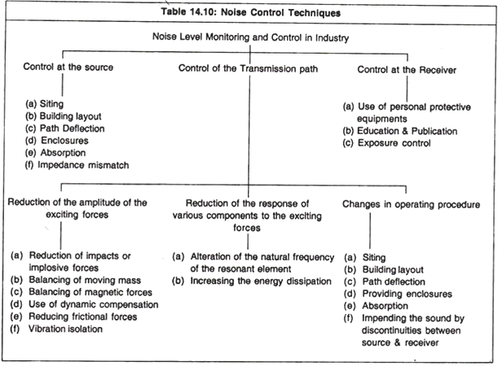

Slide 13
STUDIES OF NOISE POLLUTION IN KATHMANDU VALLEY
Government of Nepal has formulated noise level standard for different area for day and night time.
Environment Department has been established under the Ministry of Science, Technology and Environment for monitoring the environmental condition.

Slide 14
Sound quality national standard of Nepal(2012):
Location | Noise Limit, Leq (dBA)
 | Day | Night
Industrial Area | 75 | 70
Commercial Area | 65 | 55
Rural Residential Area | 45 | 40
Urban Residential Area | 55 | 50
Mixed Residential Area | 63 | 55
Peace zone | 50 | 40

Slide 15
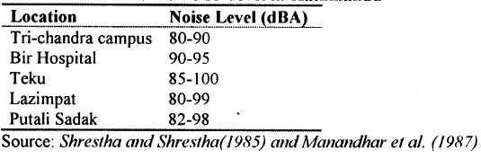
In Nepal, there were very few researches on noise pollution being carried out.
Road traffic noise levels in Kathmandu valley:

Slide 16
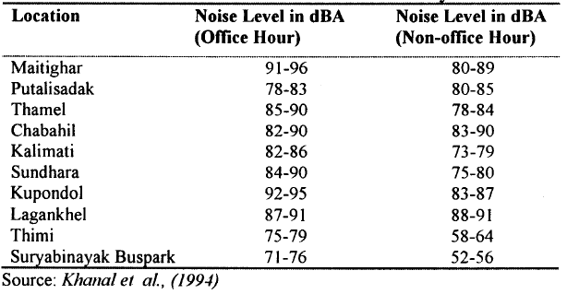

Slide 17
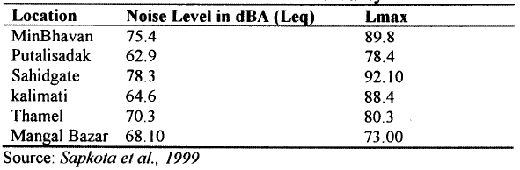

Slide 18
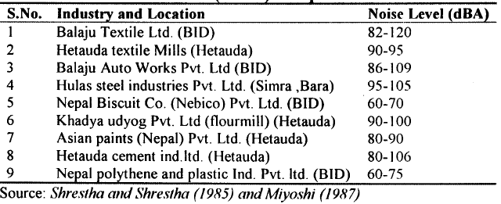
Industrial noise level (indoor) in Nepal:

Slide 19
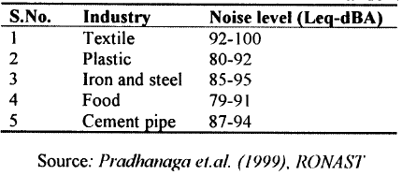
Industrial noise level in Kathmandu valley:

Slide 20
REFERENCES
Sound Quality National Standard of Nepal (2012),
Nepal Health Research Council (NHRC),
Shrestha and Shrestha (1985), Manandhar et al. (1987), Miyoshi (1987), Sapkota et al. (1999), Khanal et al. (1994)

Slide 21
THANK YOU

